Slide 1
Event pipelines on AWS with Snowplow
Michael Alberhasky
ITS-AIS – Architecture Team
michael-alberhasky@uiowa.edu

Slide 2
What is Snowplow?
Open source data collection and pipeline solution.
Runs in AWS or on-premise. Google Cloud and Azure support in the works.
Batch or real-time data processing.
Many SDKs available.
We get to own the data.

Slide 3
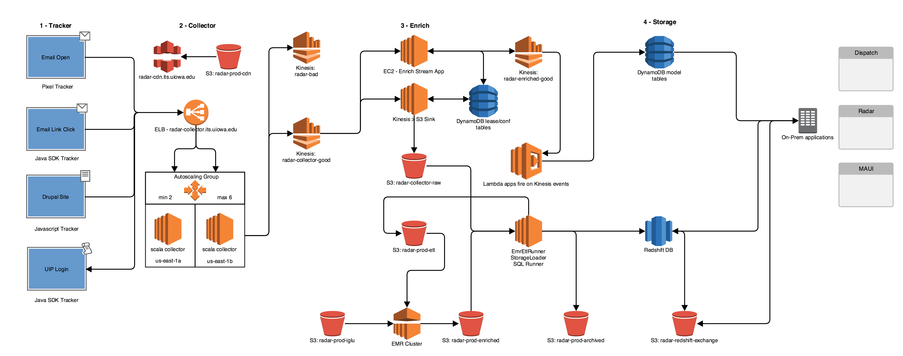
Batch vs Real-time Pipelines

