Slide 1
Two-Step Authentication
Michael Alberhasky - ITS:AIS

Slide 2
Why? Why? Why?
Phishing attacks against Employee Self-Service in Fall 2013
Attackers quickly adjusted to prompts for last four digits of SSN
SSN is an awful second factor
Critical pieces of Self-Service disabled to off-campus access

Slide 3

Duo Security
Duo provides SAAS for two-step authentication for various integrations
Multiple ways to get second factor
Used by other Big10/CIC schools
Pilot was already underway by ITSO
Internet2 consortium had an existing license agreement with Duo

Slide 4
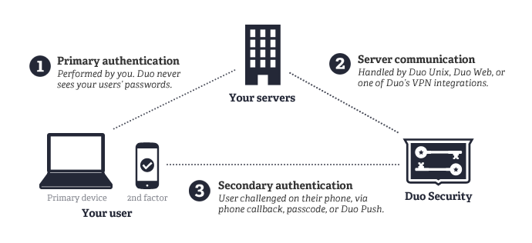
How does it work?
For the HawkId login service, we use the Duo Web integration

Slide 5
Enrollment Tool
Duo’s enrollment mechanism wasn’t viable for our campus - no way for a user to change registered devices
Initial pilot users had to rely on ITSO to make changes to their registered devices
Duo has pretty good APIs to facilitating creating your own enrollment tool
Needed something dead simple

Slide 6
What does it do?
Allows user to register one or more devices (SMS, voice, Duo Push)
Enable/disable Two-Step (2FA) requirement upon login to apps requiring 2FA
Generate offline backup codes
See setup history
Provide an API to the Help Desk
Synchronize accounts/devices with Duo

Slide 7
Stack
Play Framework 1.2.7
Oracle
Bootstrap 3.x
Duo’s Java client library
Swagger for API documentation

Slide 8
Demo

Slide 9
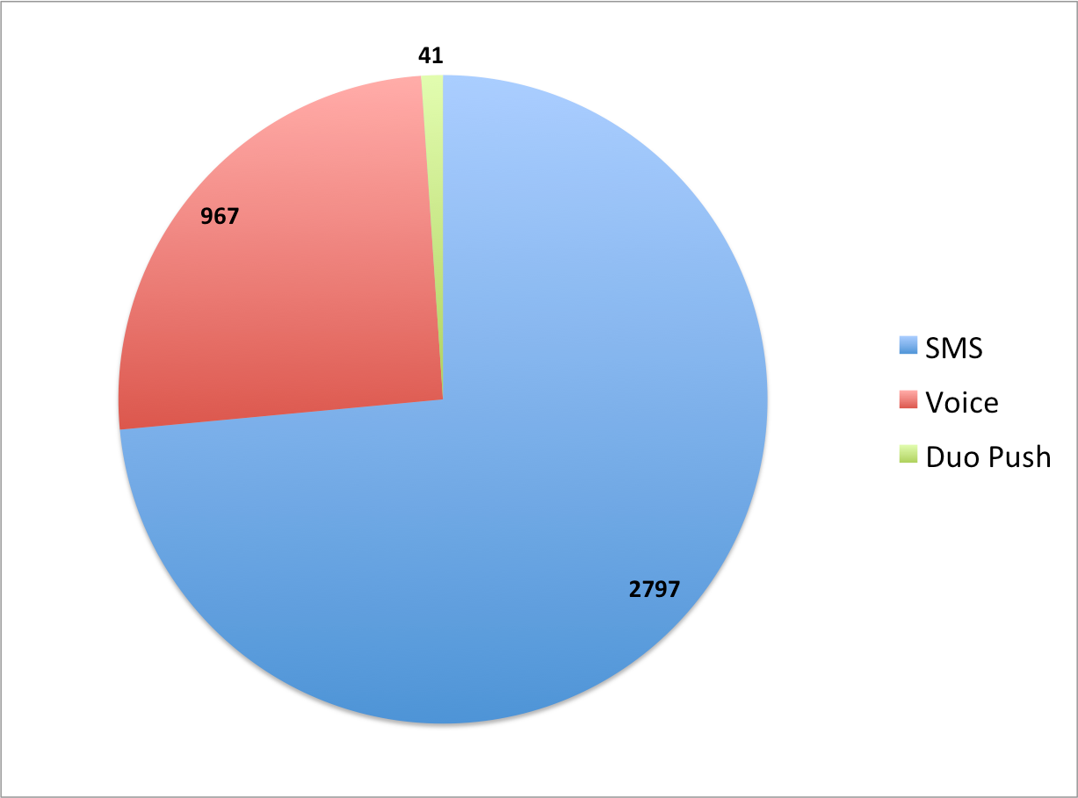
Stats
Enrollment tool launched to all of campus on May 12
3,246 employees have setup Two-Step auth
89 have turned it off after completing setup
157,000+ successful logins
Device type

Slide 10
Questions??
Michael Alberhasky
michael-alberhasky@uiowa.edu

