Slide 1


Dispatch
Data-powered communication engine
Michael Alberhasky| ITS-AIS
05/11/2016

Slide 2
Why was Dispatch built?
Built in 2012
Admissions using expensive vended product to send out recruiting materials. Difficult to use.
MAUI needed a single service to generate and send messages.

Slide 3
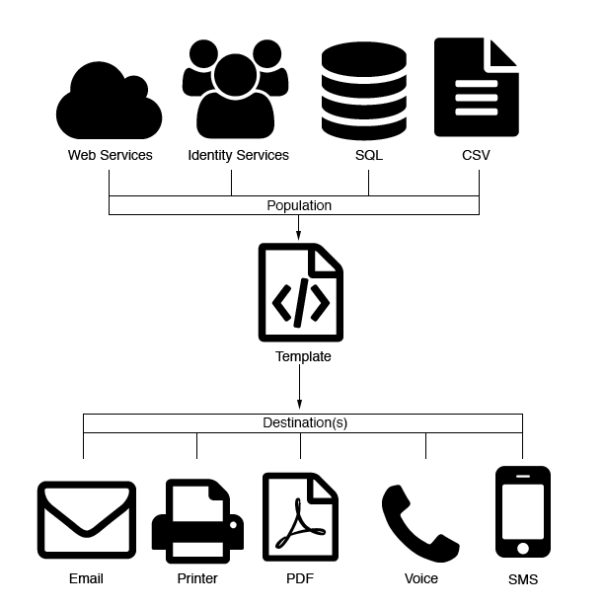
What does Dispatch do?
Utilizes institutional data sources to dynamically generate messages that can be delivered via email, print, file services, voice or SMS.

Slide 4
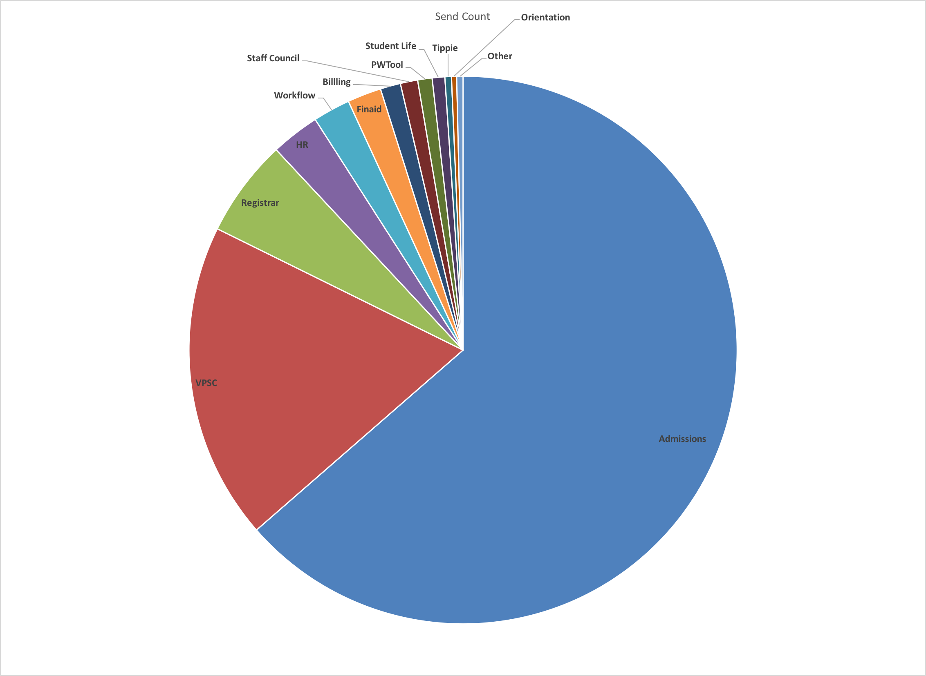
Who is using Dispatch?
Top clients by volume:
• Admissions
• VP Strategic Communications
• Registrar
• HR
• Universal Workflow
• Financial Aid
• Billing Office

Slide 5
How is Dispatch being used?
Recruiting prospective students (email)
Sending out official decision letters (email, print > printer)
Building U-Bills (print > sftp)
Universal Workflow notifications (email)
Password reset codes (SMS, voice, email)
Housing Reminder (voice)
Iowa NOW (email)
Financial Aid notices (email)
Many more…

Slide 6
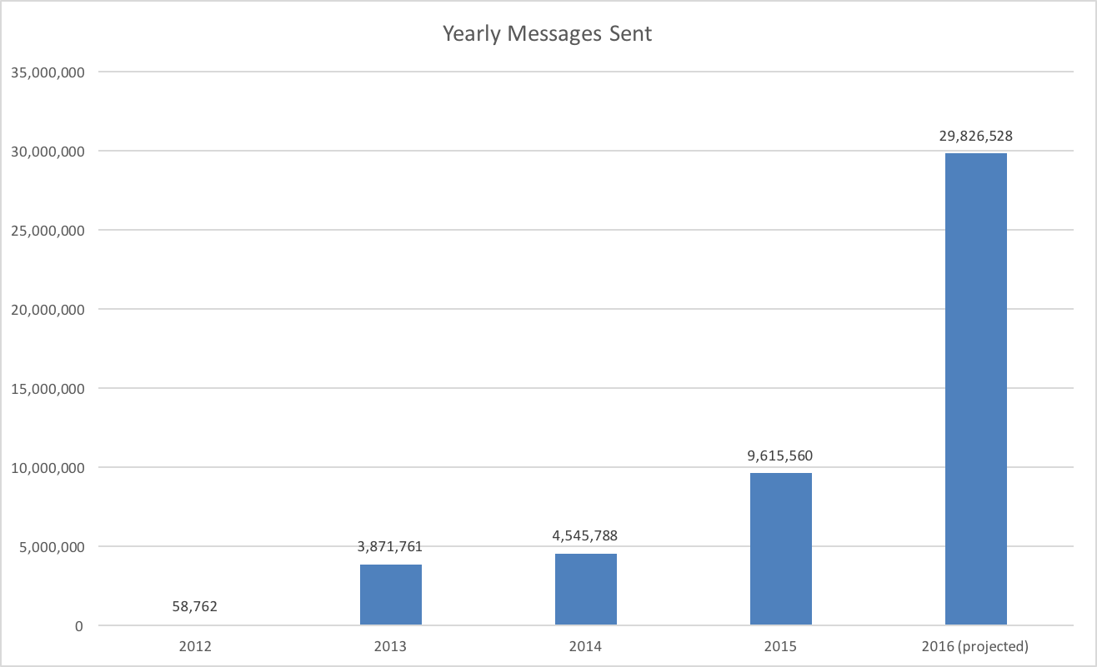
Growth

Slide 7
Concepts

Slide 8


